Slide 1
Hot Jupiter
2022311224 이진진

Slide 2
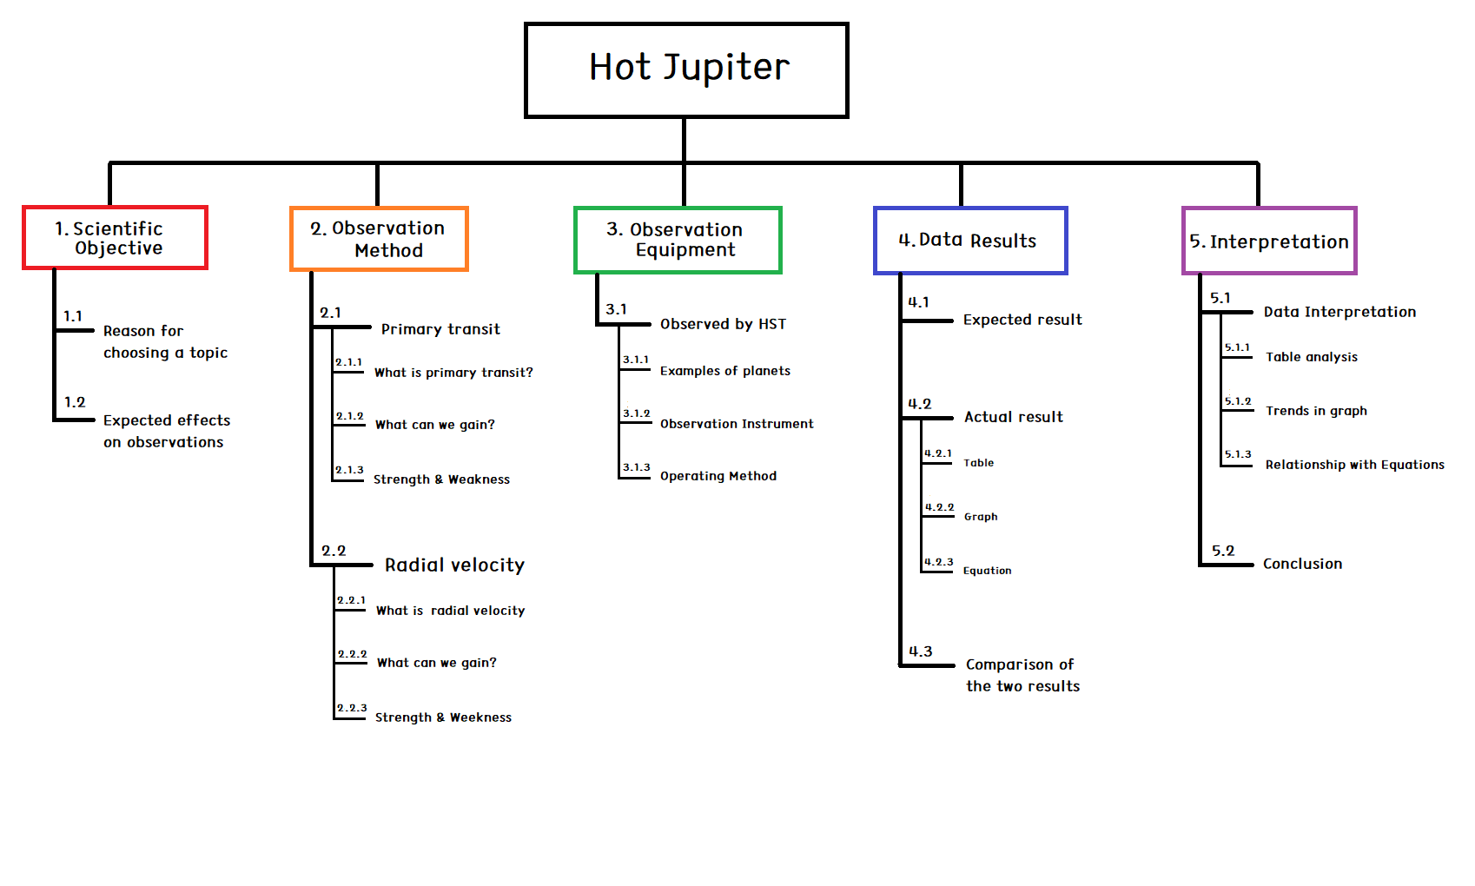
PLAN
Week 7 : Total WBS introduction / Scientific Objective 1.1, 1.2
Week 8 : Modifying overall WBS and PLAN / Observation Method 2.1, 2.2, 2.3
Week 9 : Observation Method 2.1, 2.2
Week 10 : Observation Equipment 3.1
Week 11 :
Week 12 : Data Result 4.1
Week 13 :
Week 14 : Data Result 4.2, 4.3
Week 15 : Interpretation 5.1, 5.2
Week 16 : Conference

Slide 3
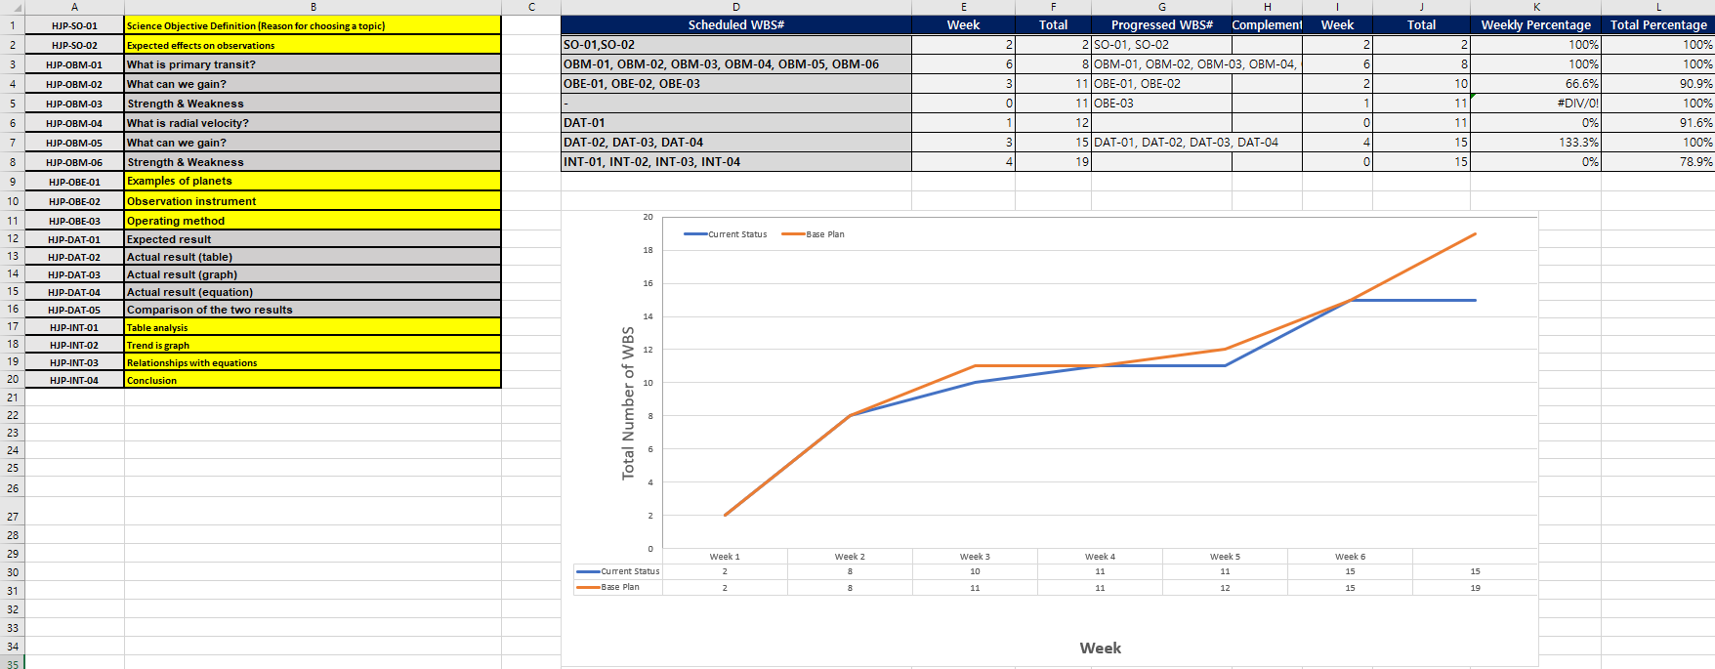
WBS

Slide 4
4.2
Actual Result – 51 Pegasi b
Radius
Distance
Orbiting velocity
4. Mass

Slide 5
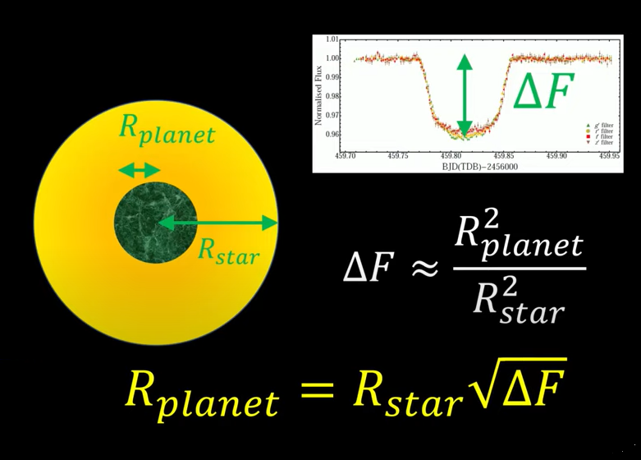
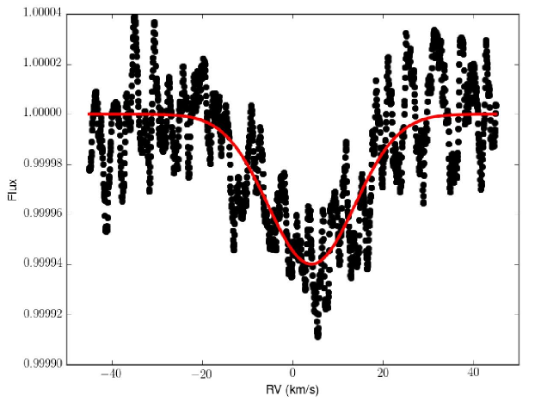
4.2
Expected Result - 51 Pegasi b
Radius (Primary transit)
R(Star) x sqrt(ΔF)
= 1.237 x (0.00006)^(1/2)
= 0.0096 R(sun)
ΔF ~ 0.00006
= 0.0096 x 696,340 km
= 6685 km (X)

Slide 6
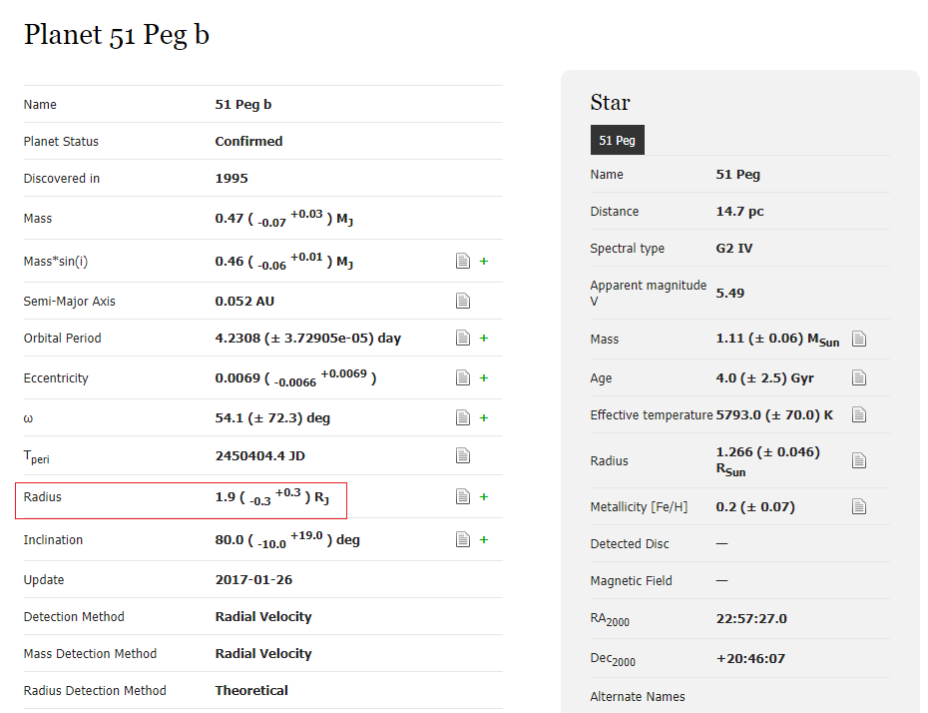
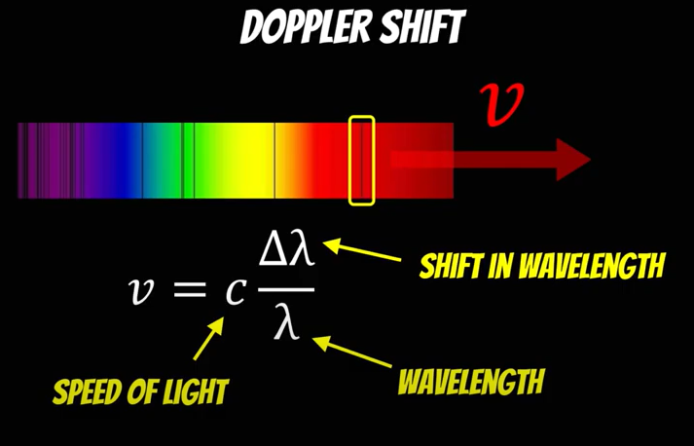
4.2
Actual Result - 51 Pegasi b
R = 135,830 km
Radius (Radial Velocity)

Slide 7
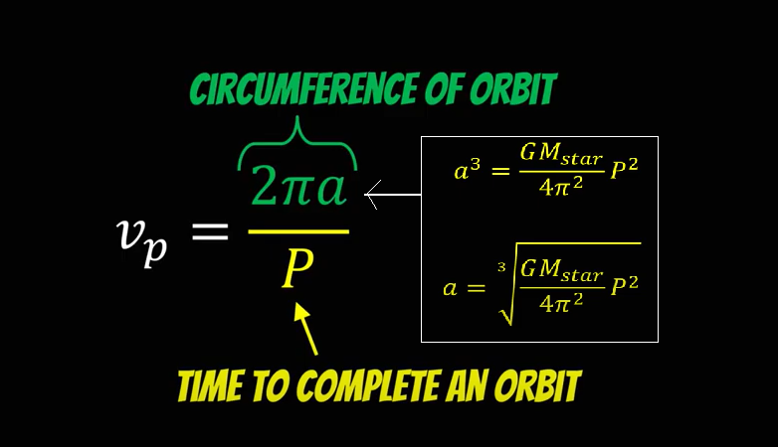
4.2
Expected Result - 51 Pegasi b
2. Distance from sun

Slide 8
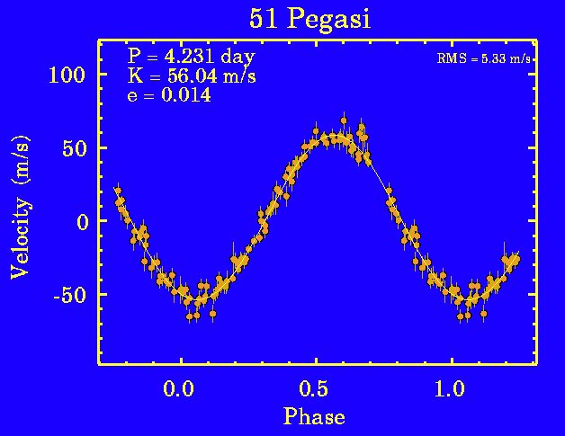
4.2
Expected Result - 51 Pegasi b
2. Distance from sun
P = 4.231 days = 365560 s
a = [GM(star) p^2 / 4 pi^2]^(1/3)
= [6.67 x 10^(-11) x 365560^2 M(star) / 4 pi^2]^(1/3)
= 7,943,504,324 m = 7,943,504 km
= 0.053AU

Slide 9
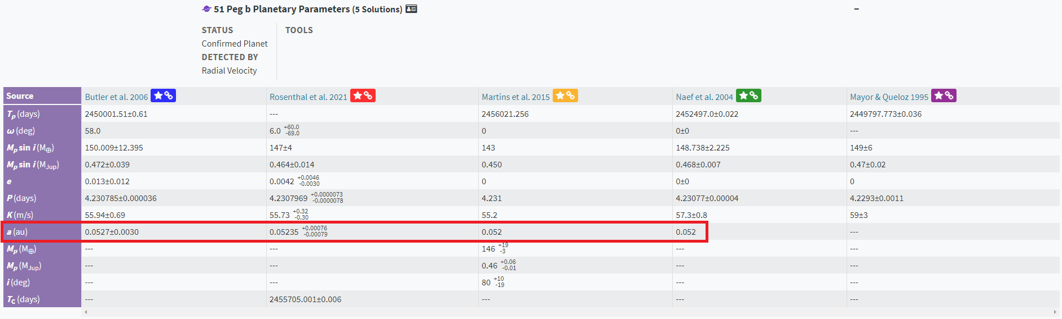
4.2
Actual Result - 51 Pegasi b
2. Distance from sun

Slide 10
4.2
Expected Data - 51 Pegasi b
3. Orbiting velocity
A = 0.053AU = 7,943,504,324 m
v = 2 pi (7,943,504,324m) / 365560s
= 136,531 m/s = 136.5 km/s

Slide 11
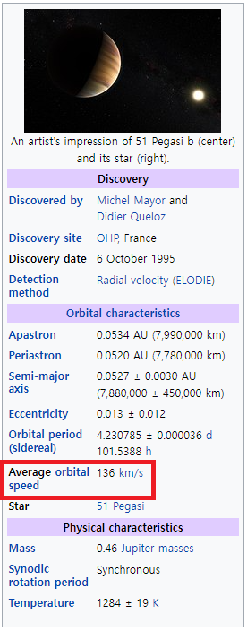
4.2
Actual Result - 51 Pegasi b
3. Orbiting velocity

Slide 12
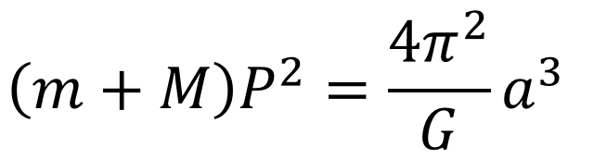
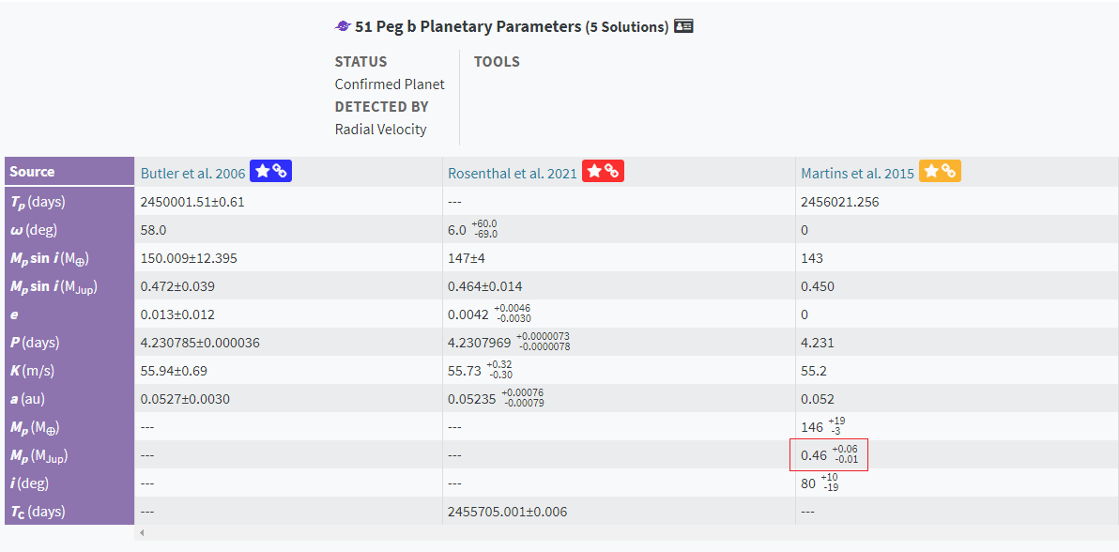
4.1
Actual Result - 51 Pegasi b
4. Mass
M = 0.46M(jup) = 0.00044M(sun)
= 8.73 x 10^26 kg

Slide 13
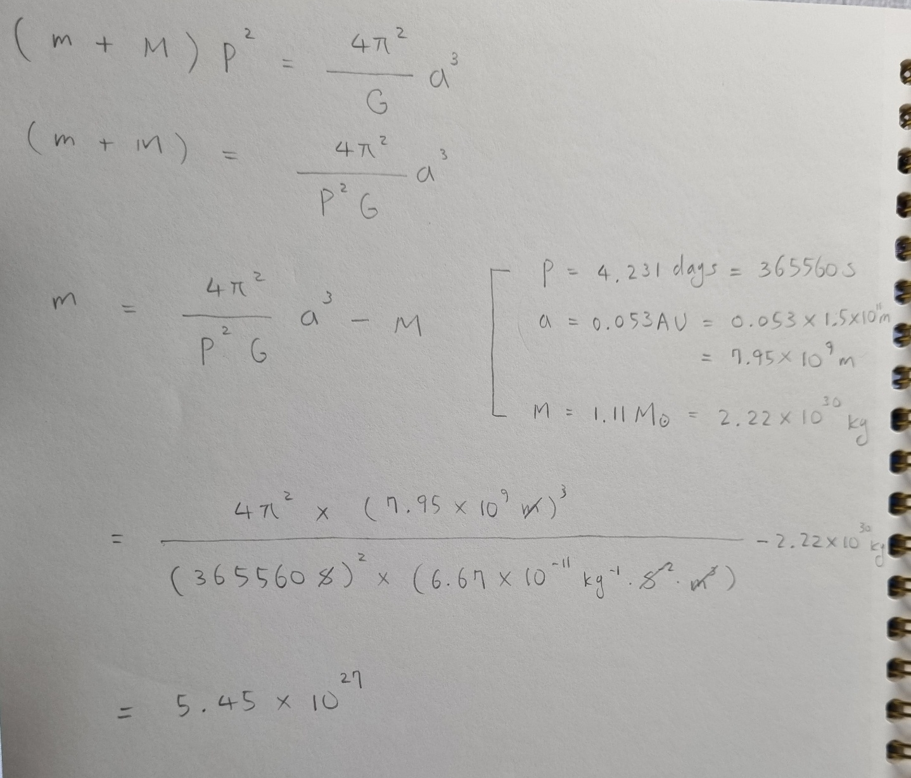
4.1
Expected Data - 51 Pegasi b
4. Mass
mp (Kg) | Ms (kg) | P (sec) | a (AU)
-1.18x10^(29) | 2.22x10^30 | 365560 | 0.005200
-9.38x10^(28) | 2.22x10^30 | 365560 | 0.052220
-6.93x10^(28) | 2.22x10^30 | 365560 | 0.05240
-4.4x10^(28) | 2.22x10^30 | 365560 | 0.05260
-1.96x10^(28) | 2.22x10^30 | 365560 | 0.05280
5.4x10^(27) | 2.22x10^30 | 365560 | 0.05300

Slide 14
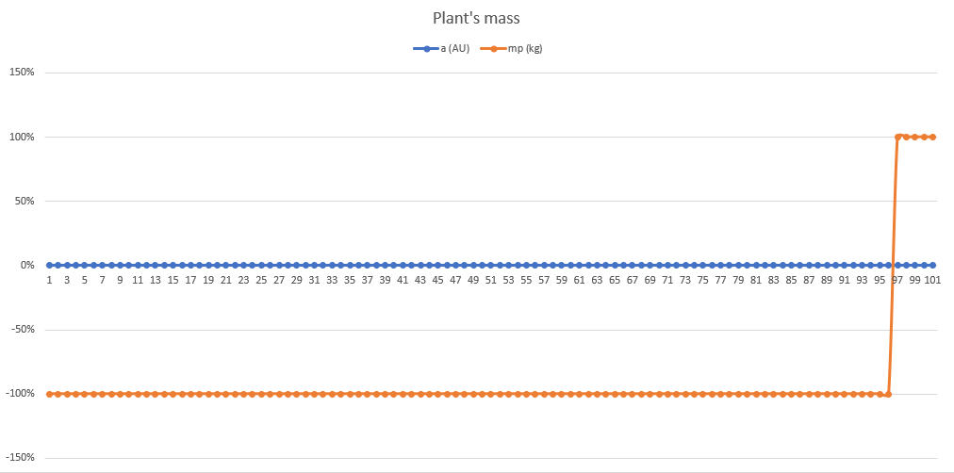
4.1
Expected Data - 51 Pegasi b
mp (Kg) | Ms (kg) | P (sec) | a (AU)
-1.18x10^(29) | 2.22x10^30 | 365560 | 0.005200
-9.38x10^(28) | 2.22x10^30 | 365560 | 0.052220
-6.93x10^(28) | 2.22x10^30 | 365560 | 0.05240
-4.4x10^(28) | 2.22x10^30 | 365560 | 0.05260
-1.96x10^(28) | 2.22x10^30 | 365560 | 0.05280
5.4x10^(27) | 2.22x10^30 | 365560 | 0.05300

Slide 15
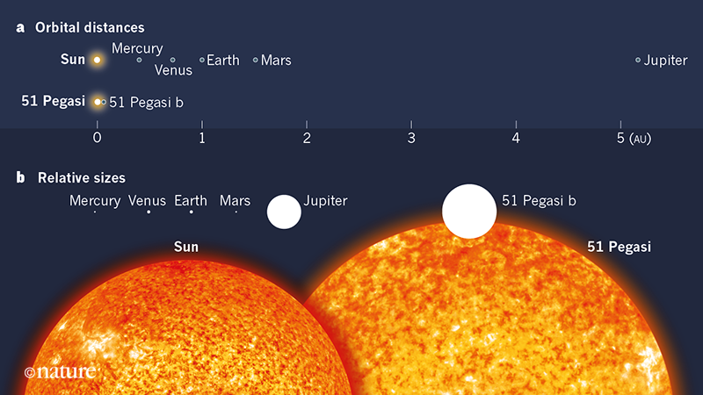
4.1
51 Pegasi b

Slide 16
WBS

Slide 17
THANK YOU
FOR LISTENING

